Slide 1
TYPE OF CONSTRUCTOR

Slide 2
Types of Constructor
There are five types of constructors available in C#, they are as follows :
Default or Parameter Less Constructor
Parameterized Constructor
Copy Constructor
Static Constructor

Slide 3
Default or Parameterless Constructors
If a constructor method does not take any parameters, then we call that a Default or Parameter Less Constructor. These constructors can be defined by a programmer explicitly or else will be defined implicitly provided there is no explicit constructor under the class. So, the Default or Parameterless Constructors are again classified into two types. They are as follows:
System-Defined Default Constructor
That constructor is called a default constructor and the default constructor is parameterless. The default constructor will assign default values to the data members (non-static variables). As this constructor is created by the system this is also called a system-defined default constructor.
User-Defined Default Constructor
The constructor which is defined by the user without any parameter is called the user-defined default constructor. This constructor does not accept any argument but as part of the constructor body, you can write your own logic.

Slide 4
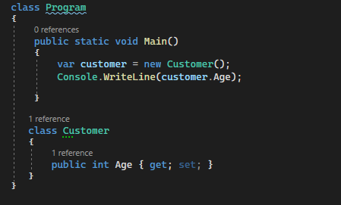

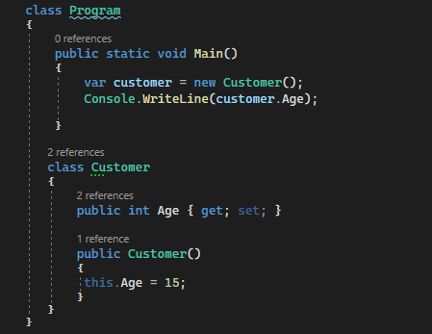

Slide 5
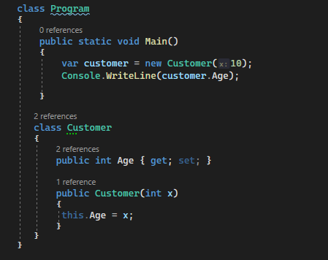

What is Parameterized Constructor
If a constructor method is defined with parameters, we call it a Parameterized Constructor in C#, and these constructors are defined by the programmers only but never can be defined implicitly. So, in simple words, we can say that the developer-given constructor with parameters is called Parameterized Constructor in C#. So, in this way, we can create any number of instances of the class, and while creating the instance we can pass different values and those values will go and sit in the variable.

Slide 6
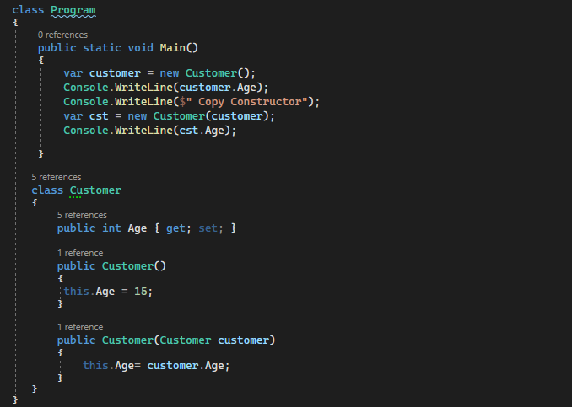

Copy Constructor
If we want to create multiple instances with the same values then we need to use the copy constructor in C#, in a copy constructor the constructor takes the same class as a parameter to it.

Slide 7
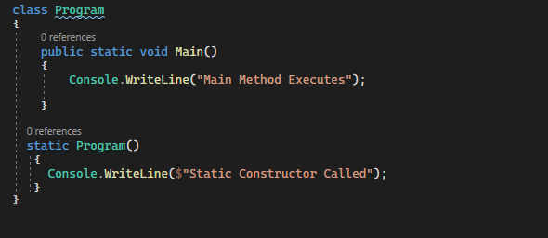

Static Constructor
In C#, it is also possible to create a constructor as static and when we do so, it is called a Static Constructor. If a constructor is declared explicitly by using the static modifier, then it is called a static constructor in C#. All the constructors we defined till now are non-static or instance constructors.
For a better understanding, please have a look at the below example. In a static constructor, you cannot use any access specifiers like public, private, and protected.
Static Constructors are responsible for initializing static variables and these constructors are never called explicitly. They are called Implicitly and moreover, these constructors are the first to execute in any class.
Static Constructors cannot be parameterized, so overloading of the static constructors is not possible in C#. Now, the question is why we cannot parameterize the static constructor? The answer is simple. The static constructors are executed implicitly and hence we never get a chance to pass a value.

Slide 8
Points To Remember About Static Constructor
There can be only one static constructor in a class.
It can’t be called explicitly, it is always called implicitly.
The static constructor should be without any parameters.
It can only access the static members of the class.
There should not be any access specifiers in the static constructor definition.
If a class is static then we cannot create the object for the static class.
It is called automatically to initialize the static members.
Static constructor will be invoked only once i.e. at the time of class loading.

Slide 9
What is a Private Constructor
In C#, it is also possible to create a constructor as private. The constructor whose accessibility is private is known as a private constructor. When a class contains a private constructor then we cannot create an object for the class outside of the class. So, private constructors are used to create an object for the class within the same class. Generally, private constructors are used in the Remoting concept.
Points To Remember about C# Private Constructor:
Using Private Constructor in C# we can implement the singleton design pattern.
We need to use the private constructor in C# when the class contains only static members.
Using a private constructor is not possible to create an instance from outside the class.

Slide 10
When the constructor is created by using the Private Access Specifier, then it is called a Private Constructor. When a class contains a private constructor and if the class does not have any other Public Constructors, then you cannot create an object for the class outside of the class. But we can create objects for the class within the same class.

Slide 11
Static vs Non-Static Constructors
If a constructor is explicitly declared by using the static modifier, we call that constructor a static constructor whereas the rest of the others are called non-static constructors only.
Constructors are responsible for initializing the fields or variables of a class. Static Fields/Variables are initialized by static constructors and non-static fields/variables are initialized by non-static or instance constructors in C#
Static constructors are implicitly called whereas non-static constructors are explicitly called.
Static Constructors execute immediately once the execution of a class start and moreover, it is the first block of code to run under a class whereas non-static constructors execute only after creating the instance of the class as well as each and every time the instance of the class is created.
Static Constructors are executed only once whereas the non-static constructors are executed 0 or n number of times depending on the number of instances we created for the class
Non-Static Constructors can be parameterized whereas the static constructors cannot have any parameter. This is because we explicitly call the non-static constructors, so we can have a chance to pass parameters. On the other hand, static constructors are implicitly called and it is the first block of code to run under a class, and hence we don’t have any chance to pass parameters.

Slide 12
Non-Static Constructors can be overloaded whereas static constructors cannot be overloaded. Overloading is something that comes into the picture based on the parameters. As we have a chance to pass parameters in the case of non-static constructors, overloading is possible. On the other hand, we cannot pass parameters to static constructors i.e. static constructors are parameterless, and hence overloading is not possible.
Every class contains an implicit constructor if not defined explicitly and those implicit constructors are defined based on the following criteria.
Every class except a static class contains an implicit non-static constructor if not defined with an explicit constructor.
Static constructors are implicitly defined only if that class contains any static fields or else that constructor will not be present provided that the class does not have an explicit static constructor.

